Slide 1
MACHINE LEARNING
CH ABHISHEK - PES1201700194
MAHESH H A – PES1201701667
RAKESH DEVANI – PES1201701602

Slide 2
PROBLEM STATEMENT:
Predicting the type of breast cancer i.e. Malignant or Benign based on the characteristics of diseased cell as provided in the dataset.
The Class distribution as given in the dataset is,
Malignant tumors [ 34.5% ]
Benign tumors [ 65.5% ]
Using the above info, we try to classify the data such that we will be able to predict the breast cancer is malignant or benign.

Slide 3
K-NEAREST NEIGHBOURS [ KNN ]
KNN is a simple, lazy learning, easy to implement supervised ML algorithm which solves both classification and regression problems.
Here, when a prediction is required, the k-most similar records to a new record from the training dataset are then located. From these neighbors, a summarized prediction is made.
Steps for implementation are,
Calculate Euclidean Distance
Get nearest neighbours
Make predictions

Slide 4
LOGISTIC REGRESSION [ LR ]
This is a supervised classification & a predictive analysis algorithm based on the concept of probabilities.
Here, the main difference from linear regression is that the output value being modeled is a binary values (0 or 1) rather than a numeric value.
It uses a sigmoid function to map predicted values to probabilities.

Slide 5
F – SCORES :
The F score, also called the F1 score is a measure of a test’s accuracy.
It is defined as the weighted harmonic mean of the test’s precision and recall.
It provides a more realistic measure of a test’s performance by considering both precision and recall.

Slide 6
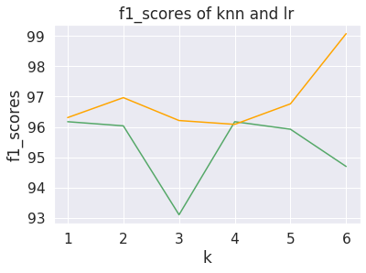
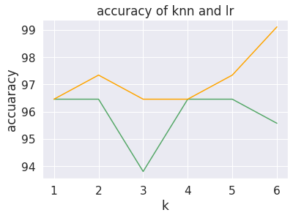
PERFORMANCE GRAPHS

Slide 7
CONCLUSION
We observed that KNN takes longer duration when compared to logistic regression [ LR ].
But, the accuracy of both KNN and logistic regression were almost the same.

Slide 8
THANK YOU

